Slide 1
Transport Layer
Content: Chapter 6 - Tanenbaum mixed with
Chapter 4 - Kurose
Outline:
Role of Transport Layer
Related Problems and Solutions
TCP/IP Transport protocols

Slide 2
The Role of the Transport Layer
network layer: logical communication between hosts
transport layer: logical communication between processes
relies on, enhances, network layer services
application
transport
network
data link
physical
logical end-end transport
application
transport
network
data link
physical

Slide 3
Multiplexing/demultiplexing
multiplexing at sender:
handle data from multiple
sockets, add transport header (later used for demultiplexing)
demultiplexing at receiver:
use header info to deliver
received segments to correct
socket
application
application
P1
P2
application
socket
P3
transport
P4
process
transport
network
transport
network
link
network
link
physical
link
physical
physical

Slide 4
Sockets
Definition:
A socket is one endpoint of a two-way communication link between two programs running on the network. A socket is bound to a port number so that the transport layer can identify the application that data is destined to be sent to.
An endpoint is a combination of an IP address and a port number. Every TCP connection can be uniquely identified by its two endpoints. That way you can have multiple connections between your host and the server.
Socket API (Application Programming Interface)

Slide 5
Socket Programming in Python or C
Return socket descriptor (s)
Create socket descriptor
socket( )
socket( )
binds ip+port to s
Assigns protocol addresses to the socket
bind ( )
S
E
R
V
E
R
C
L
I
E
N
T
Indicates queue size and listening
listen ( )
Request Connection
Wait for connections request
accept ( )
connect( )
(read)
recv ( )
send ( )
(write)
(write)
send ( )
recv ( )
(read)
Closes socket and finishes connection
close ( )
close ( )

Slide 6
Programming Details (1)
Little Endian versus Big Endian: how to store a number in memory:
Little Endian: stores the lowest order bytes first. Used in Intel architecture. Ex: 0x12345678 would be stored as (0x78 0x56 0x34 0x12)
Big Endian: 0x12345678 would be stored as (0x12 0x34 0x56 0x78). Used in RISC architectures. The network format.
Htons: host to network – unsigned short int to Bigendian.
Htonl: host to network – unsigned long int to Bigendian

Slide 7
Programming Details (2)
struct sockaddr_in channel: data structure to specify a local or remote endpoint address to connect to the socket:
channel.sin_addr.s_addr=htonl(INADDR_ANY)
“This allowed your program to work without knowing the IP address of the machine it was running on, or, in the case of a machine with multiple network interfaces, it allowed your server to receive packets destined to any of the interfaces”.
Defines which version the address family will come from:
Server Address setting
channel.sin_family = AF_INET Address Family for Internet Sockets is IPv4

Slide 8
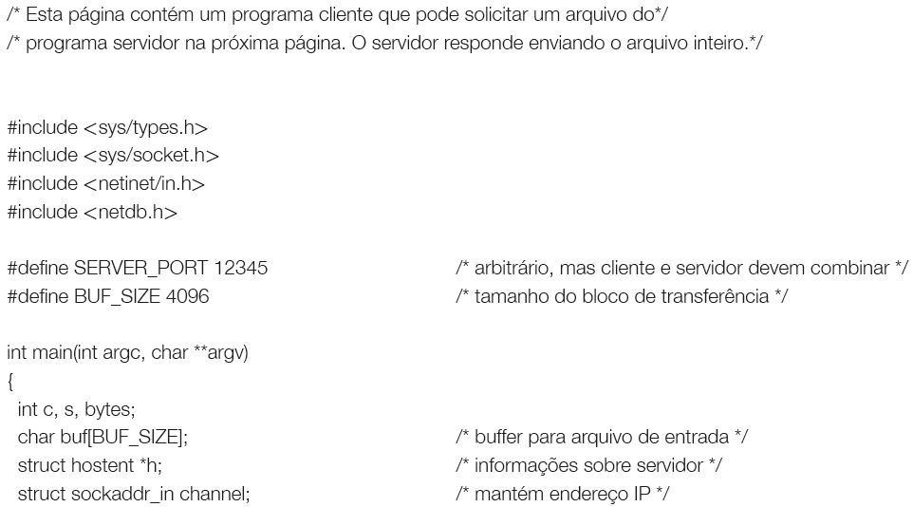
Requests server file : client <url> <file> >f
Client (1)

Slide 9
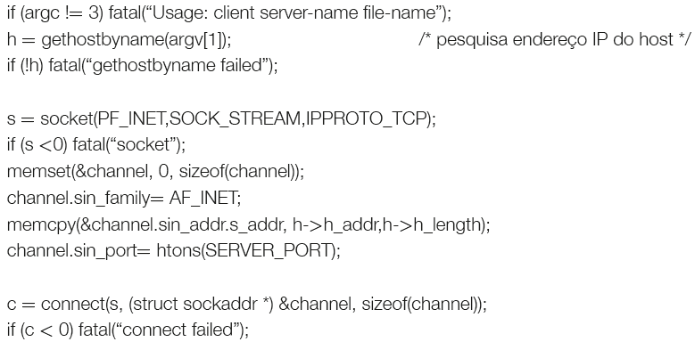
Client (2)
9

Slide 10
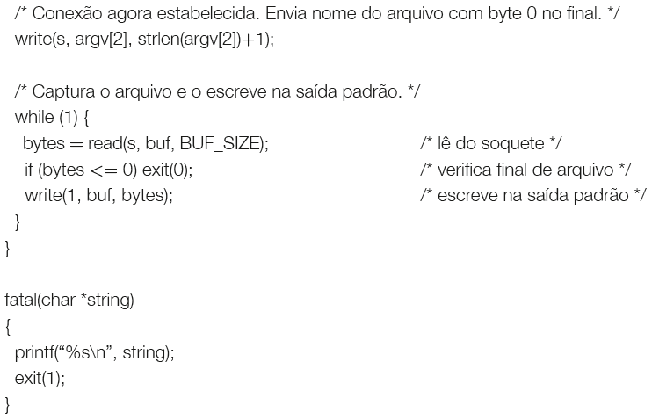
Client (3)
10

Slide 11
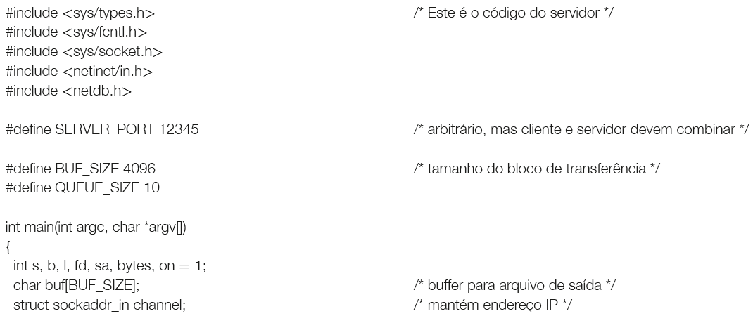
Server (1)
11

Slide 12
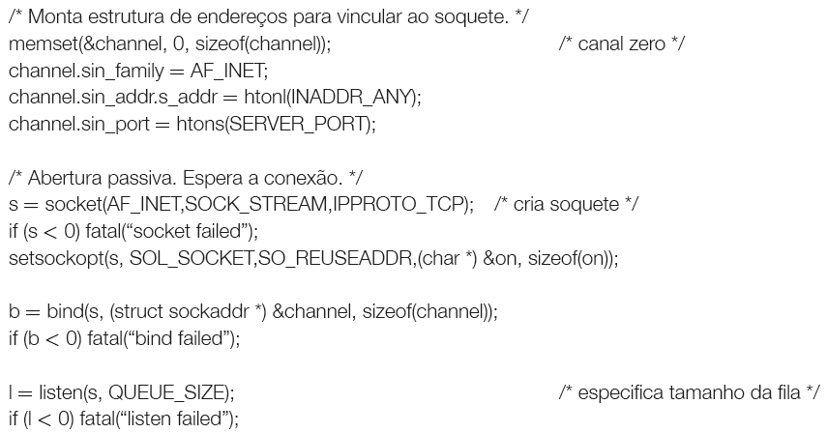
Server (2)
12

Slide 13
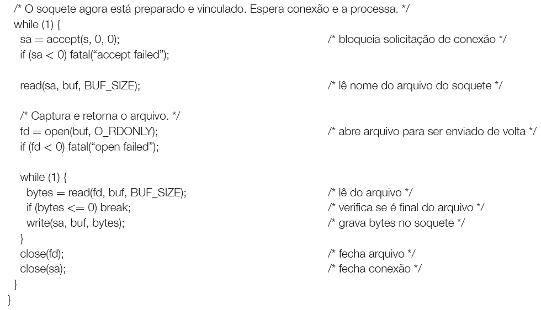
Server (3)
13

Slide 14
Transport Layer
Outline:
Role of Transport Layer
Related Problems and Solutions:
Problem 1: Reliability vs Urgency
Problem 2: How to address ?
Problem 3: How to treat losses ?
Problem 4: How to treat congestion?
TCP/IP Transport protocols

Slide 15
Problem 1: Reliability vs Urgency
Two types of service:
Connectionless - UDP:
no handshaking between UDP sender, receiver
each UDP segment handled independently of others
Connection-oriented - TCP:
handshaking - exchange of control msgs. Phases:
Connect -> Transfer -> Disconnect.
A segment is a message handled by the transport entities.

Slide 16
Problem 2: How to Address ?
TCP/IP – transport address => port number
A process should know which port is related with a service:
Extracted from /etc/services:
daytime 13/udp
ftp 21/tcp
telnet 23/tcp
smtp 25/tcp mail
IANA – Internet Assigned Numbers Authority globally coordinates DNS Root, IP addressing, and other Internet protocol resources.

Slide 17
IANA Internet Assigned Numbers Authority
(http://www.iana.org/assignments/service-names-port-numbers/service-names-port-numbers.xhtml)
“ The port numbers are divided into three ranges:
System Ports (Well Known): from 0 through 1023.
User Ports (Registered ): from 1024 through 49151
Dynamic and/or Private Ports: from 49152 through 65535.
(Detalhes vide RFC6335)
The System Ports are assigned by the IETF process for standards-track protocols (and on most systems can only be used by system (or root) processes ). The User Ports are assigned by IANA using the “Expert Review” process . Dynamic Ports are not assigned. ”

Slide 18
Portmapper
How do I request a connection to software that does not use familiar ports? Through the portmapper process:
When creating a service, the application registers itself in the portmapper;
A client requests a known port connection associated with the portmapper (usually port 111); the portmapper returns the port number associated with the desired service;
The user terminates the connection with the portmapper and establishes a new connection with the new address provided.
If an application has high demand, it is better to wait for the connections directly, instead of using the portmapper
Portmapper is equivalent to phone directory assistance.

Slide 19
inetd Process Server
The portmapper may be associated with a process server - inetd (in the UNIX case).
Do I need a process waiting for connections for each service?
Yes and No. Applications that are not so widely used could be activated on demand: a process server waits for requests and activates the process that can handle them.
If the application has high demand should be waiting for connections directly.
19
Notes:
19

Slide 20
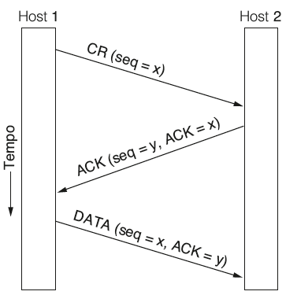
Problem 3: How to treat losses ?
Use Acknowledge. Idea: a CR message to request a connection and ACK message to accept.
Problem: The network may lose, delay, corrupt, or replicate packets (due to retransmissions). The usual cases must be implemented to perform well, but the protocol must deal with unusual cases as well.
The 3-way handshake is the better choice.
3 way handshake in normal scenario

Slide 21
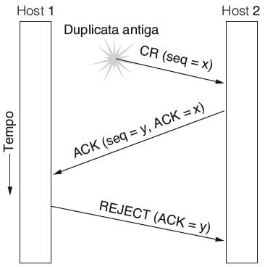
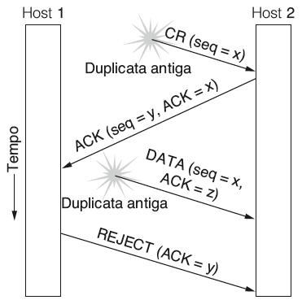
Establishing connections on L4
(1) Old duplicate CR
Seq=x
Seq=z, Ack=x
(2) Duplicate CR and ACK
Seq=x
Host 1 realizes that it is duplicate
Seq=z, Ack=x
Seq=x, Ack=z
Host 2 realizes that ACK=z is duplicate
21
Notes:
21

Slide 22
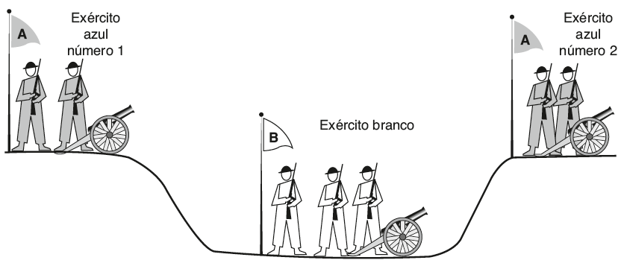
Problem of the two Armies
Blue Army Number 1
Blue Army Number 2
White Army

Slide 23
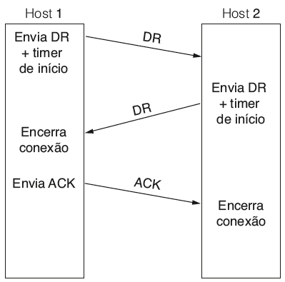
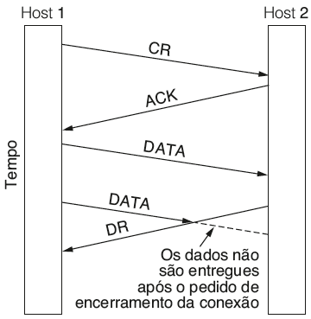
Closing a connection on L4 (1)
Abrupt Closing with Data Loss
Normal case with 3-way Handshake
23
Notes:
23

Slide 24
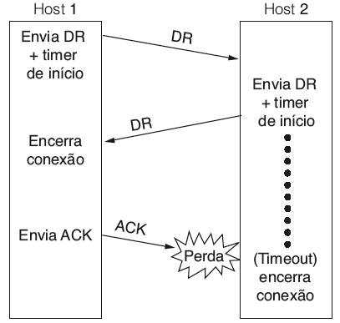
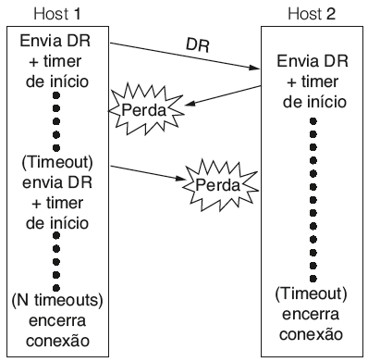
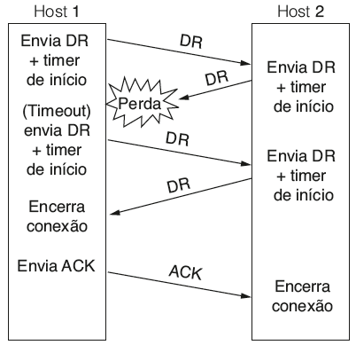
Closing a connection on L4 (2)
ACK lost
DR answer and DR Lost
DR answer Lost
24
Notes:
24

Slide 25
Problem 4: How to treat congestion?
What is congestion ?
informally: “too many sources sending too much data too fast for network to handle”
different from flow control!
manifestations:
lost packets (buffer overflow at routers)
long delays (queueing in router buffers)
a top-10 problem!
25

Slide 26
Who cares ?
(a) Goodput x load (b) Corresponding delay
Although congestion occurs in routers, therefore detected by the network layer, it is caused by traffic sent to the network by the transport layer and therefore is a joint responsibility of these layers.
26

Slide 27
Causes/costs of congestion: scenario 1
original data: λ_{in}
throughput: λ_{out}
two senders, two receivers
one router, infinite buffers
output link capacity: R
no retransmission
Host A
unlimited shared output link buffers
Host B
R/2
λ_{out}
delay
λ_{in}
R/2
λ_{in}
R/2
maximum per-connection throughput: R/2
large delays as arrival rate, λ_{in}, approaches capacity

Slide 28
Causes/costs of congestion: scenario 2
one router, finite buffers
sender retransmission of timed-out packet
application-layer input = application-layer output: λ_{in} = λ_{out}
transport-layer input includes retransmissions : λ_{in} λ_{in}
‘
λ_{in} : original data
λ'_{in}: original data, plus retransmitted data
λ_{out}
Host A
finite shared output link buffers
Host B

Slide 29
Causes/costs of congestion: scenario 2
R/2
idealization: perfect knowledge
sender sends only when router buffers available
λ_{out}
λ_{in}
R/2
λ_{in} : original data
copy
λ'_{in}: original data, plus retransmitted data
λ_{out}
A
free buffer space!
finite shared output link buffers
Host B

Slide 30
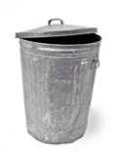
Causes/costs of congestion: scenario 2
Idealization: known loss packets can be lost, dropped at router due to full buffers
sender only resends if packet known to be lost
λ_{in} : original data
copy
λ'_{in}: original data, plus retransmitted data
λ_{out}
A
no buffer space!
Host B

Slide 31
Causes/costs of congestion: scenario 2
Idealization: known loss packets can be lost, dropped at router due to full buffers
sender only resends if packet known to be lost
R/2
when sending at R/2, some packets are retransmissions but asymptotic goodput is still R/2 (why?)
λ_{out}
λ_{in}
R/2
λ_{in} : original data
λ'_{in}: original data, plus retransmitted data
λ_{out}
A
free buffer space!
Host B

Slide 32
Causes/costs of congestion: scenario 2
Realistic: duplicates
packets can be lost, dropped at router due to full buffers
sender times out prematurely, sending two copies, both of which are delivered
R/2
when sending at R/2, some packets are retransmissions including duplicated that are delivered!
λ_{out}
λ_{in}
R/2
λ_{in}
copy
λ'_{in}
λ_{out}
timeout
A
free buffer space!
Host B

Slide 33
Causes/costs of congestion: scenario 2
Realistic: duplicates
packets can be lost, dropped at router due to full buffers
sender times out prematurely, sending two copies, both of which are delivered
R/2
when sending at R/2, some packets are retransmissions including duplicated that are delivered!
λ_{out}
λ_{in}
R/2
“costs” of congestion:
more work (retrans) for given “goodput”
unneeded retransmissions: link carries multiple copies of pkt
decreasing goodput

Slide 34
Causes/costs of congestion: scenario 3
Q: what happens as λ_{in} and λ_{in}’ increase ?
four senders
multihop paths
timeout/retransmit
A: as red λ_{in}’ increases, all arriving blue pkts at upper queue are dropped, blue throughput g 0
Host A
λ_{in} : original data
λ_{out}
Host B
λ'_{in}: original data, plus retransmitted data
finite shared output link buffers
Host D
Host C

Slide 35
Causes/costs of congestion: scenario 3
C/2
λ_{out}
λ_{in}’
C/2
another “cost” of congestion:
when packet dropped, any “upstream transmission capacity used for that packet was wasted!

Slide 36
Congestion Control - Solutions
Where to take action?
Find a good allocation of bandwidth: fair, with good performance, avoiding congestion;
Adjust flow rate;
Consider the particularities of Wireless Networks - although in theory, transport layer is independent of the link layer, in practice, it is necessary to consider the wired and wireless differences.
36

Slide 37
Desirable Bandwidth allocation
37

Slide 38
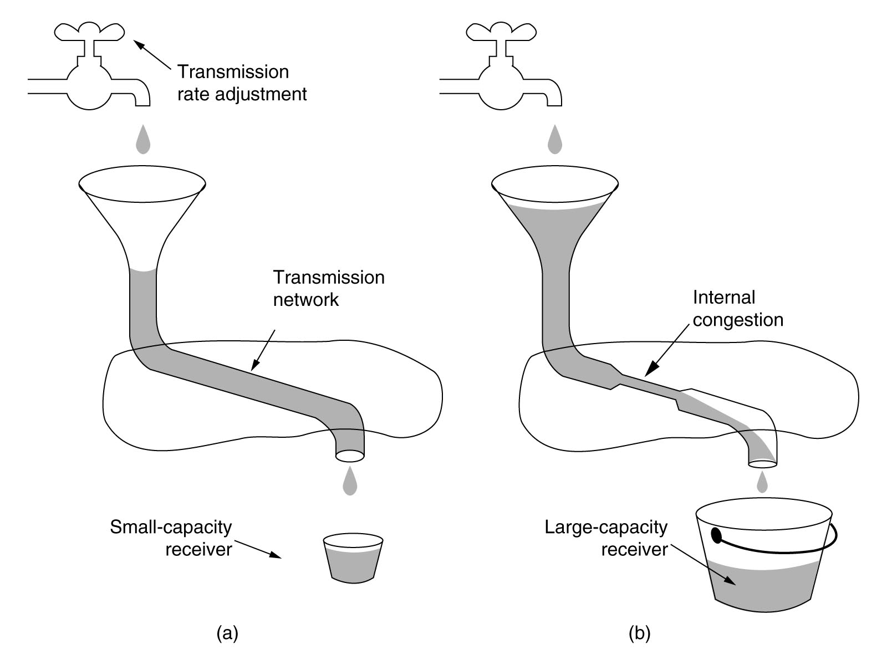
Controlling the Flow Rate (1)
(a) The limit is the small capacity receiver;
(b) The limit is the internal network.
Flow control helps in congestion control

Slide 39
Controlling the Flow Rate (2)
The criterion for flow rate control has an important effect on performance.
AIMD - Additive Increase Multiplicative Decrease
How much to increase? (TCP has its own algorithm)

Slide 40
Particularities of Wireless Networks
In the Theory: transport protocols are independent of the network and link technologies.
In practice: TCP uses packet loss as a congestion signal, but wireless networks lose packets by error, not congestion. Worse: the nodes move and the quality of the link varies.
Different solutions for different scenarios.
Google has a new algorithm TCP-BBR (Bottleneck Bandwidth and Round-trip propagation time):
https://techcrunch.com/2017/07/20/google-cloud-gets-a-new-networking-algorithm-that-improves-internet-throughput/
40

Slide 41
Transport Layer
Outline:
Role of Transport Layer
Related Problems and Solutions:
Problem 1: Reliability vs Urgency
Problem 2: How to address ?
Problem 3: How to treat losses ?
Problem 4: How to treat congestion?
TCP/IP Transport protocols
UDP
TCP

Slide 42
User Data Protocol - UDP
why is there a UDP?
no connection establishment (which can add delay)
simple: no connection state at sender, receiver. Good for applications with the behavior - request, response - not needing connection establishment overhead. The response is the acknowledgment of the request. If the answer does not arrive, ask again.
small header size
no congestion control: UDP can blast away as fast as desired

Slide 43
UDP: segment header
length, in bytes of UDP segment, including header
32 bits
source port #
dest port #
length
checksum
application
data
(payload)
UDP segment format
43

Slide 44
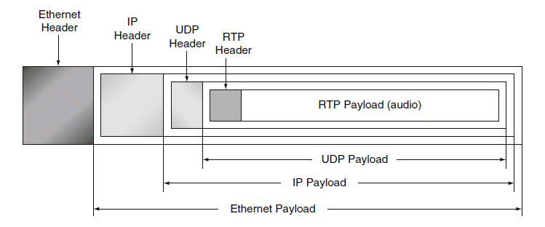
RTP – Real-Time Transport Protocol
Several multimedia applications rely on a real-time transport protocol. RTP numbers the packets for the application to decide what to do with packets and losses, but RTP does not retransmit - no time.
It is considered transport protocol implemented in the application layer

Slide 45
TCP - Transmission Control Protocol Overview RFCs: 793,1122,1323, 2018, 2581
point-to-point:
one sender, one receiver
reliable, in-order byte steam:
no “message boundaries”
pipelined:
TCP congestion and flow control set window size
full duplex data:
bi-directional data flow in same connection
MSS: maximum segment size
connection-oriented:
handshaking (exchange of control msgs) inits sender, receiver state before data exchange
flow controlled:
sender will not overwhelm receiver

